Slide 1
Recreation
Ms Maryam Zahra
Department of Health & Physical Education
LCWU Lahore.
Email:maryamsyed565@gmail.com

Slide 2
Recreational Activities
People who take part in park activities such as walking, hiking, or skiing, schedule fewer office visits, maintain lower body fat percentages, and have lower blood pressure and cholesterol levels. Mental wellness is critical to overall physical health. Participating in recreational activities helps manage stress.

Slide 3
Definition
Activity done for enjoyment when one is not working.
Recreation is an activity of leisure, leisure being discretionary time.
The "need to do something for recreation" is an essential element of human biology and psychology

Slide 4
Importance of recreation
Taking part in recreational activities, particularly outdoors, can improve your physical wellness. In fact, people who frequently take advantage of park activities have fewer doctor visits, lower body mass indexes and lower systolic blood pressures than those who don't, according to Dr. Laura L. Payne of the University of Illinois. A 2005 California State Parks report also highlights that outdoor recreation provides an excellent opportunity to increase exercise. It cites a 2001 study revealing that the availability of recreational facilities in a location impacts the amount of physical activity in which residents participate.
Physical Benefits of Recreation

Slide 5
Mental wellness is critical to overall physical health. Participating in recreational activities helps manage stress. Taking time to nurture oneself provides a sense of balance and self-esteem, which can directly reduce anxiety and depression.
Mental Health Improvements

Slide 6
Recreation areas provide gathering places for families and social groups, as well as for individuals of all ages and economic status, regardless of their ability to pay for access.
Parks and recreation programs provide places for health and well-being that are accessible by persons of all ages and abilities, especially to those with disabilities.
Recreation is linked to improving quality of life.
Access to parks and recreation opportunities has been strongly linked to reductions in crime and to reduced juvenile delinquency.
Recreation programs and parks provide a sense of public pride and cohesion to every community
Social Importance

Slide 7
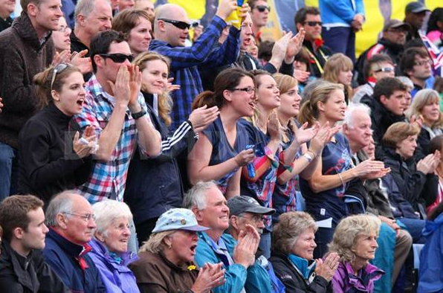
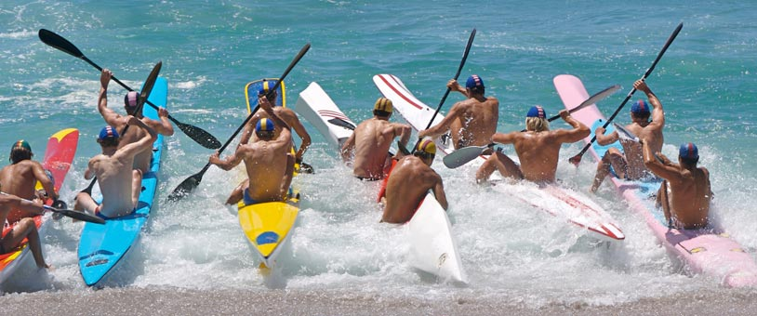
Classifications of Recreational Activities
Spectator Type
Participant Type

Slide 8
Spectator Type People spend their time watching the event and derive enjoyment from it.
Participant Type People do not gain enjoyment merely by watching; they do so by joining the activity.

Slide 9
Active Type Active Type
People have to function effectively in promoting. the action .
Passive Type
People have no excessive movement in performing the task or action

Slide 10
Physical and Mental
Physical Activity People exerts efforts and bodily functions in performing the action.
Mental Activity The mind is doing the functions with less body movement.

Slide 11
Public Type
Involves the general public.
Private Type
Confined to people working in a private companies.
Commercial Type
Endorsing products which are open to everybody.

Slide 12
Characteristics of Recreation
 Involves Activity
 No single form
 Determined by motivation
 Occurs in unobligated time
 Voluntary participated
 Universally sought and practical
 By- products
 Gives direct satisfaction

Slide 13
Values in Leisure and Recreation
Physical Health
Psychological Health
Social well-being
Emotional stability
Big business

Slide 14
Scope of Recreation
 Indoor Activities Games and Sports chess, parlor games b. Dance Activities: stop dance, trip to Jerusalem c. Music Activities: singing, instrumental playing d. Drama Activities: story telling, comedy skits e. Arts and Crafts: origami, pop- up cards f. Hobby and Collecting Activities: cooking, dancing, stamp collections, antique collection
Outdoor Activities a. Games and Sports: dual and team sports b. Dance Activities: street dancing, aerobics c. Music Activities: singing contest during fiesta d. Nature and Outdoor Activities: camping, hiking, field trips, picnic, excursions e. Arts and Crafts: painting, drawing f. Hobby and Collecting Activities: f.1. bowling, tennis, f.2. billiard, fishing

Slide 15
Leisure
free time when you're not meeting social or bodily needs"
Social needs are things like work and chores
Bodily needs are mainly eating and sleeping
Most people spend the rest of their time doing some form of recreation
Participating in leisure and recreation activities can help you better manage stress and reduce depression. Leisure provides you the chance to find balance in your life; it also puts you in control of how you're spending your time, which is an important consideration because you may feel overwhelmed by obligations.

Slide 16
A great stress reliever.
Encourage you to take a break.
Offer new challenges and experiences.
Allow you to explore yourself and your talents.
Help improve your career.
Can provide additional income.
Help you build self-confidence and improve your self-esteem.
Allow you to meet new people.

Slide 17
Increases in Leisure Time
People now have more leisure time than they used to. This is because:
We spend less time working and have more holidays
More people are retiring earlier
More unemployment - as machines make jobs easier and so requiring fewer people
Less household chores - machines are also making our home chores easier, for example washing machines and dish washers
For these reasons, people are spending more time on recreational activities. Therefore the need is also there for more facilities and services for people to do this. This is why there has been a large growth in the leisure industry in recent years.

Slide 18
Influence of Others
What type of sports you play, and whether you play sports at all, is heavily influenced by the people around you - family and friends.
Family
Some parents encourage their children into sports
Some sports need lots of specialist equipment and clothing and so some might not be able to afford it
Parents are needed to transport their children to and from training and competitions

Slide 19
Friends / Peers
The group of friends that you spend most of your leisure time with. This is your peer group.
Young people tend to get involved in and enjoy the same activities as their peers
The groups attitude towards sport rubs off on the individuals, so if they don't like sport the individual will start playing less sport and vice versa

Slide 20
Thank You

